Slide 1
SQL Server 2025 – Utilizzare l’AI con Ollama
Danilo Dominici

Slide 3




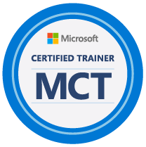

Chi è Danilo Dominici
Senior consultant, MCT, ex-MVP SQL Server, PostgreSQL, Power BI – Azure, AWS
ddominici@sqlserverinfo.it
linkedin.com/in/danilodominici
github.com/ddominici/presentations
25 anni
2014-2020

Slide 4








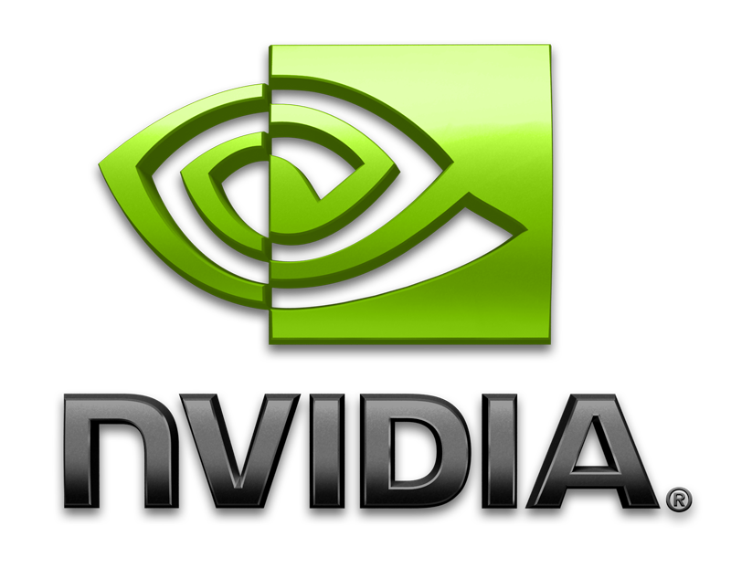
















SQL Server 2025
The AI-ready enterprise database from ground to cloud
AI built-in
Develop modern
data applications
Integrate your data
with Fabric
Secure by default
Mission critical engine
Connected
with Arc
Managed
DR
Assisted by Copilots
Benchmark¹
leader
Built for all
platforms
1 All TPC Claims as of 11/18/2025 https://www.tpc.org/3408, https://www.tpc.org/3409, https://www.tpc.org/3410

Slide 5


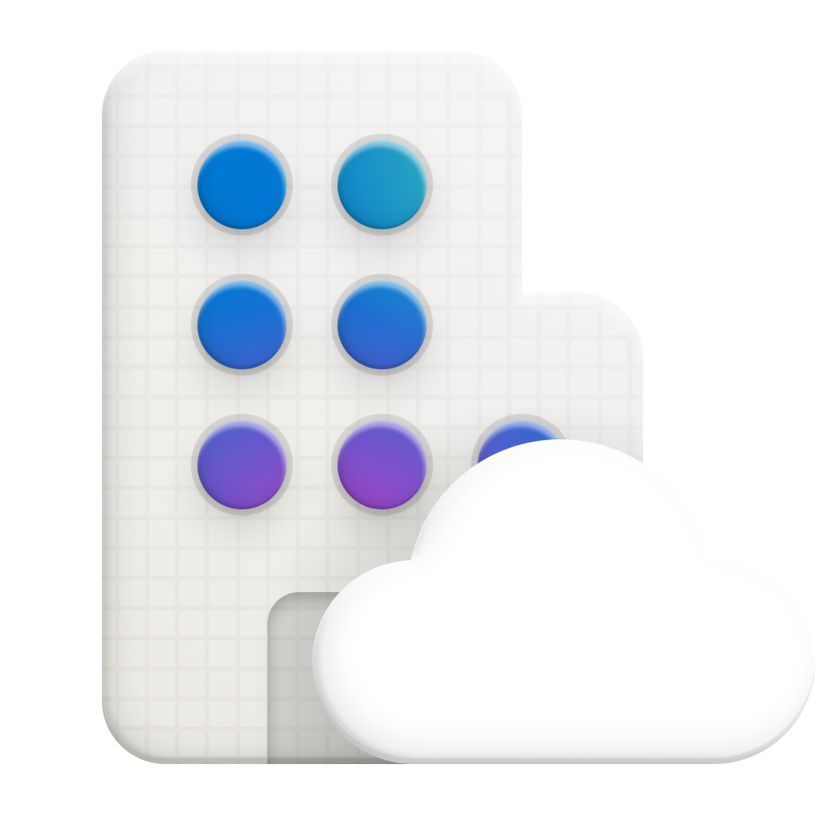
No pricing or licensing changes
SQL Server 2025 editions
The AI-ready enterprise database from ground to cloud
Express
Free, entry-level database for small AI, web and mobile apps
Standard
Full featured database with extensive scale for mid-tier applications
Enterprise
Highest performance and scaling for business-critical workloads
Feature highlights
50 GB maximum relational databases size
Up to 4 cores of CPU
Up to 1410 MBs of memory
Built-in vector search and semantic search
Native JSON type support
External REST endpoint invocation
Change event streaming
Microsoft Entra ID authentication
Mirroring in Fabric
Feature highlights
Feature highlights
NEW
+ Express features
+ Express and Standard features
Up to 32 cores of CPU
Up to 256 GB of memory
Optimized locking
Resource Governor
ZSTD Backup Compression Algorithm
Basic Availability Groups
Azure SQL Managed Instance link
Accelerated Database Recovery
Backups to S3-compatible object storage
524 PB maximum relational databases size
Highest core count supported
Highest memory supported
Built-in Intelligent Query Processing
Online and Resumable Index Operations
Availability Groups: including distributed and contained
Query Store for readable secondaries
Persisted Statistics for Secondary Replicas (Query store)
NEW
NEW
NEW
NEW
NEW
NEW
NEW
NEW
NEW
NEW
NEW
Developer
Free to use for dev/test in non-production environments
Standard Developer
Enterprise Developer
NEW

Slide 6
What problems are we trying to solve with AI?
Smarter searching on your existing text data
Bring in other documents/text for centralized vector searching
Provide building blocks - Intelligent assistants, RAG, AI Agents
Take advantage of AI in a secure and scalable fashion
Overcome complexity by using the familiar T-SQL language

Slide 7







Vector search with your data
Secure and scalable
Vector (semantic) and Hybrid Searches
Embeddings in
Vector store
Database
or
Index
Your data
Prompt
Prompt
=
Embedding
Prompt
Prompt
+ search results
Generated
response
Augmented Generated response
Embedding
Model
Prompt
App or AI Agent
Retrieval Augmented
Generation (RAG)
Application
Language
Model
The prompt may contain words not found in your data!

Slide 8






What are the features?
Vector Store
Native vector data type and DiskANN index*
Model Management
Secure Model definitions ground or cloud
Embeddings built-in
Text Chunking and embedding generation
Build Agentic RAG patterns
Inside the engine
Simple semantic searching with hybrid
Vector distance (KNN) and Vector search (ANN)*
Framework integration
LangChain, Semantic Kernel, EF Core, Agent Framework
*Enabled by PREVIEW_FEATURES

Slide 9

Security, SQL, and AI
Off by default!
You control all access with SQL security
You control AI models ground or cloud isolated
Data exchange with AI models is encrypted
Use RLS, TDE, Dynamic Data Masking, and Auditing
Ledger for immutable agentic operations log

Slide 10
















SQL Server 2025 Vector Architecture
Locally hosted REST HTTPS
Cloud hosted REST HTTPS
Model
definition
T-SQL
Generate
Embeddings
T-SQL Prompt
AI Services and
Language Extensions
Network hosted REST HTTPS
Generate
Embedding
for prompt
API_TYPE
Azure OpenAI
OpenAI
Ollama
ONNX Runtime*
Vector
and
Hybrid
Search
Create
vector
index
Existing data

Slide 11

Ollama

Slide 12
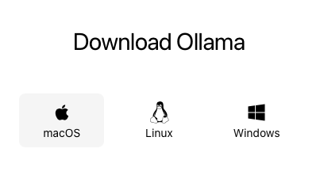
Che cos’è Ollama
Piattaforma per eseguire language models localmente sul proprio computer
Può essere installato su ogni S.O.
Anche su Docker

Slide 13
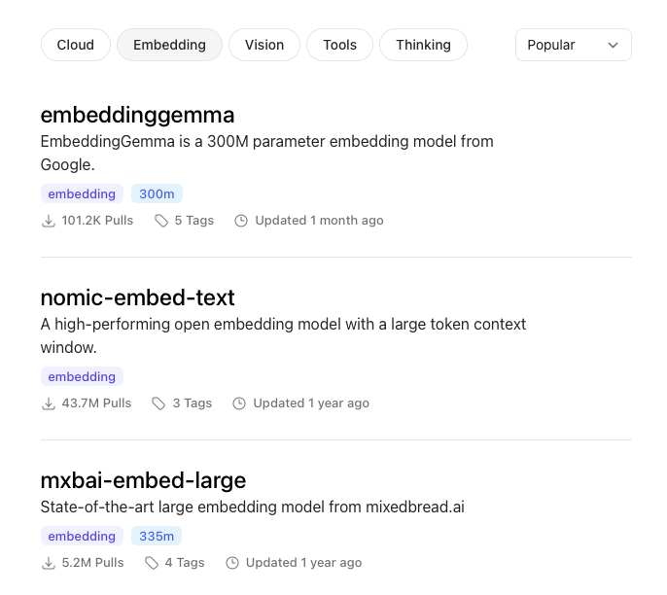
Scegliere il modello più adatto
Per task
Per utilizzo di memoria

Slide 14
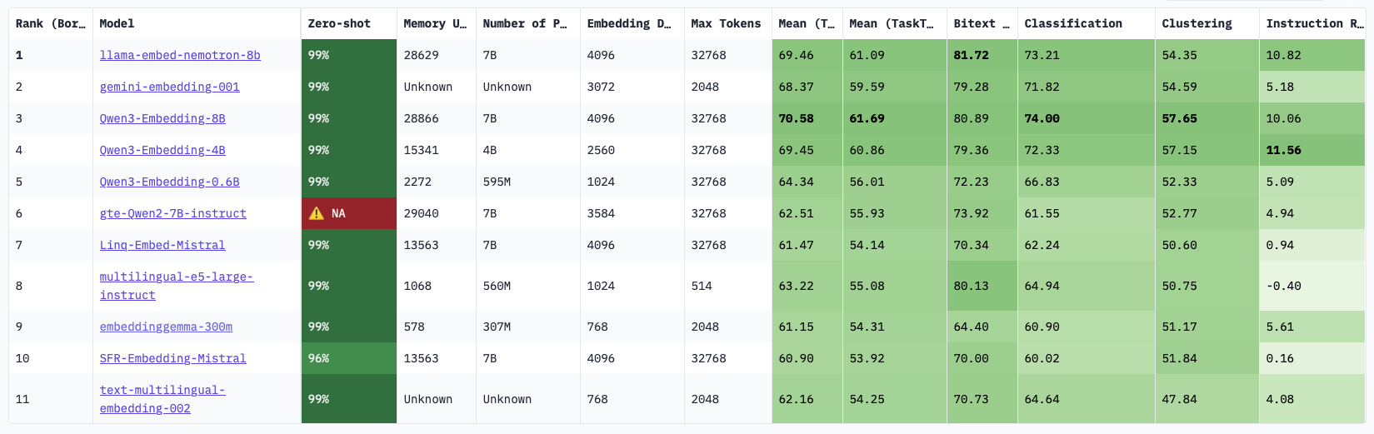
Scegliere il modello più adatto
Hugging Face mantiene una leaderboard dei modelli
utile per identificare i migliori modelli

Slide 15
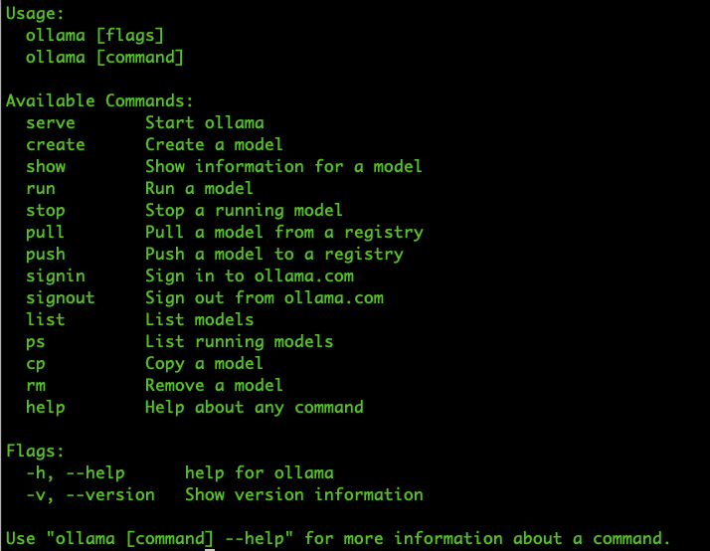
Interagire con Ollama
Client command-line
list
pull
show
Serve
…

Slide 16
Demo

Slide 17
Best practices
Usa modelli leggeri
Esegui inferenze in batch
Mantieni logging e tracciabilità delle chiamate AI
Monitora performance e tempi di risposta
Utilizza cache dei risultati per ridurre le chiamate alle API
E quindi costi e latenza
Es. Redis

Slide 18
Ollama & performance
Problema: chiamare un servizio di embedding esterno a SQL Server via REST su HTTPs è limitato dalla banda del backend.
Con dataset molto grandi i tempi di attesa possono essere molto lunghi

Slide 19


Ollama & performance
Soluzione: bilanciare le chiamate di generazione degli embedding utilizzando istanze multiple di Ollama bilanciate ad esempio da Nginx.

Slide 20
Sicurezza
Come ogni software, anche Ollama può avere bug e falle di sicurezza:
File Disclosure Vulnerabilities (CVE-2024-39722, CVE-2024-39719)
Vulnerabilità dei modelli
Dare priorità nel disegnare l’architettura alla sicurezza:
Principio di esposizione minima
Verifica della disponibilità ed analisi degli aggiornamenti
Accesso multilivello: combinare firewall, restrizione degli indirizzi IP e segmentazione di rete per minimizzare la possibilità di accesso non desiderato

Slide 21
Demo tempo permettendo…

Slide 22









The SQL Server 2025 Platform Architecture
Azure AI Agent
Azure
Microsoft Fabric
Microsoft Entra
Foundry Models
Azure Functions
Azure EventHub
Managed Identity
Embeddings
Mirroring
Change Event Streaming
Azure Arc
Reliable Failover
Query Store
Tuning
Diagnostics
Backups
Data API Builder
GraphQL
Vectors
JSON
RegEx
Concurrency
Performance
Security
Availability Group
Ai Agents
Secondary Replica
Agent framework
Managing the Server
SQL Server 2025
sp_invoke_external_rest_endpoint
GitHub Copilot
Local Dev Container
Embeddings
SSMS with Copilot
Local
REST service endpoint
Agentic RAG
AI Agents
Local AI Models
VS Code mssql

Slide 23








Call to Action
Check out MS blogs
aka.ms/sqlserver2025blog
Download it today
aka.ms/getsqlserver
Read the docs
aka.ms/sqlserver2025docs
Get the decks
aka.ms/sqlserver2025decks
Get the demos
aka.ms/sqlserver2025demos
Get SSMS 22
aka.ms/ssms
Learn from MS videos
aka.ms/Build/sql2025mechanics
aka.ms/SQL2025videos
Take the Learn challenge
aka.ms/SS25LearnChallenge

Slide 24

Il vostro feedback è importante!

